Slide 1

R.A.V.E.Birds
My Experience Training the Realtime Audio Variational AutoEncoder
EP-345 Final Project by Gibran Mobarak

Slide 2
Project Goal
Train the Realtime Audio Variational AutoEncoder developed at IRCAM by Antoine Caillon
Bird sounds are often described as very musical and I wanted to see how R.A.V.E handels data that is musical but not quite music.
A birdsong model would be an interesting compositional tool to use to blend the line between natural and electronic sounds.

Slide 3
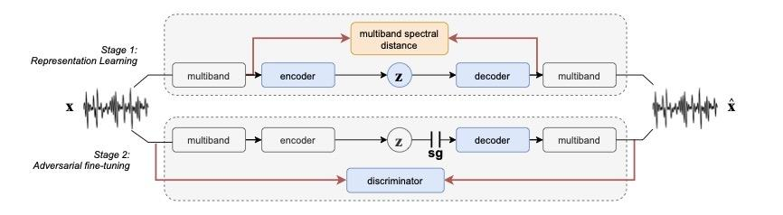
Really Fast RAVE Overview
Realtime Style transfer tool
Interfaces with Max using nn~
data is fed to an encoder which projects the data as a point in a latent representation which is then fed to a decoder to try to bring the original image back.
During training latent organization occurs and the encoder learns high level features about the input while the decoder gets better at recreating the input
57.7 Mil trainable parameters

Slide 4
Training Process
Used a birdsong dataset from The Macaulay Library at Cornell
Collected over 9 hours of clean bird recordings
Edited out any human talking and any major silence
Matched each clip length
16 bit mono Wavs
Colab Overview
Maxpat Demo

Slide 5
MORE TRAINING TIME != BETTER MODEL
My original dataset might have had too much silence because the final model that I trained for 250 epochs (~24 hours) sounds pretty similar to the one I trained for 50.
This means there was a flaw in my large dataset
My initial data concerns
Quality
Field recordings can have a lot of noise coming from wind, water, the human recording, and other animals
Length/Dead space
Some of the recordings have a little bit of space between each bird call
When training R.A.V.E I don’t want the attention window of the model to randomly choose the 5 seconds with a lot of silence.

Slide 6
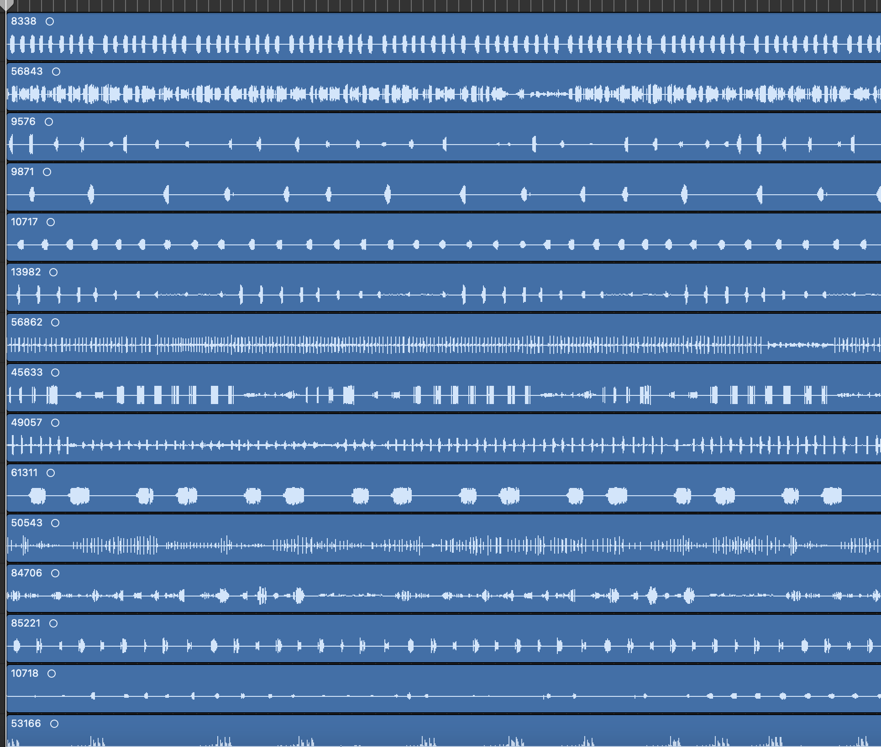
Retraining With a Smaller Dataset
Retried with a smaller dataset containing only the loudest samples with the least amount of silence.
Roughly 4 hours of audio
Did not have the chance to train for as long (~4 hours)
Still running into similar issues as the larger dataset

Slide 7
Accomplishments
Learned more about practical frustrations that one encounters when training a more complex model.
Learned a lot more about data management and preprocessing for AI projects
I think learning how to train and work with AI models is a good skill to have especially for a musician as these types of tools get better and more popular

Slide 8
Future implementation
I really want to get this to sound good for compositional applications
I want to try making the individual wav files shorter with almost no silence (1shot bird calls)
This might help focus the training on the birdcalls
RaveVST export
MaxforLive export

